Slide 1
Recognizing and Overcoming Unconscious Bias
Angela R. Logan, Ph.D.
Associate Teaching Professor
St. Andre Bessette Academic Director of the Master of Nonprofit Administration
University of Notre Dame

Slide 2
Goals for Today
Define unconscious bias and understand how it appears in our daily lives
Develop strategies to overcome unconscious bias personally, professionally, and globally
Be uncomfortable in the discomfort

Slide 3
Ground Rules
Confidentiality
Amnesty
Participate, Don’t Dominate
Value one another’s experiences
Own and embrace your own feelings
Respect
Listen to understand
Empathy
Be open to changing your minds
Disagree without being disagreeable
“No Hitting, No Biting!”

Slide 4
Students
Colleagues

Slide 5
Notes:
Poll Title: What's one question you want answered during today's session? https://www.polleverywhere.com/free_text_polls/1T6t5vWmP212UwKHkGajr

Slide 6
What is Unconscious Bias?
Unconscious bias is a result of our limited cognitive capacity. The brain’s automatic, unconscious sifting and sorting of visual, verbal and behavioral cues to determine whether people are friendly or not means that we all develop unintentional people preferences.
Over time, our brains associate things. They form neural pathways, which become stronger every time these associations are recognized and unconsciously affirmed.

Slide 7
Where Do All Our Unconscious Associations and Unintentional People Preferences Come From?
Media exposure
Family
School
Friends
Experiences
Work culture

Slide 8
Examples of Unconscious Bias
“A father and son were involved in a car accident in which the father was killed and the son was seriously injured. The father was pronounced dead at the scene of the accident and his body was taken to a local morgue. The son was taken by ambulance to a nearby hospital and was immediately wheeled into an emergency operating room. A surgeon was called. Upon arrival and seeing the patient, the attending surgeon exclaimed “Oh my God, it’s my son!’ Can you explain this?”
- Pendry, Driscoll, & Field (2007)
TTUN
Leaving Campus
“That’s My Notre Dame” story
IAT
Notes:
Break out groups 5-7 minutes to discuss the IAT or times of unconscious bias in your life

Slide 9
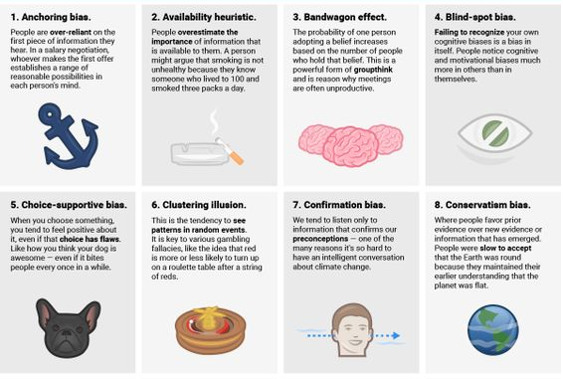
According to Organizational Psychologist Adam Grant, there are 20 Types of Cognitive Biases:

Slide 10
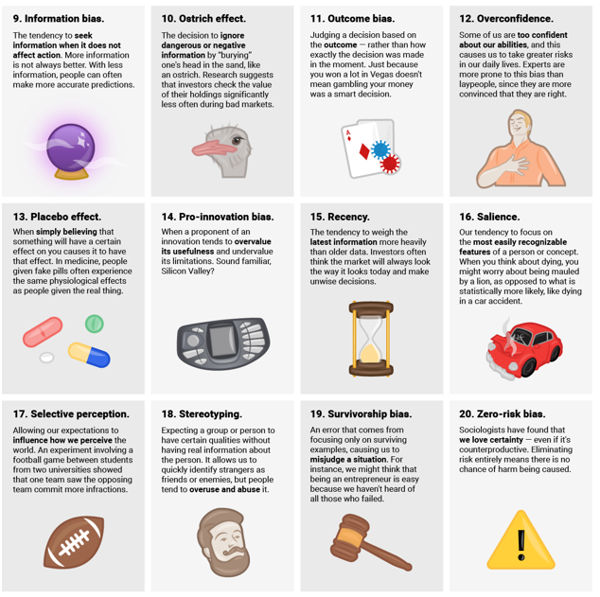

Slide 11
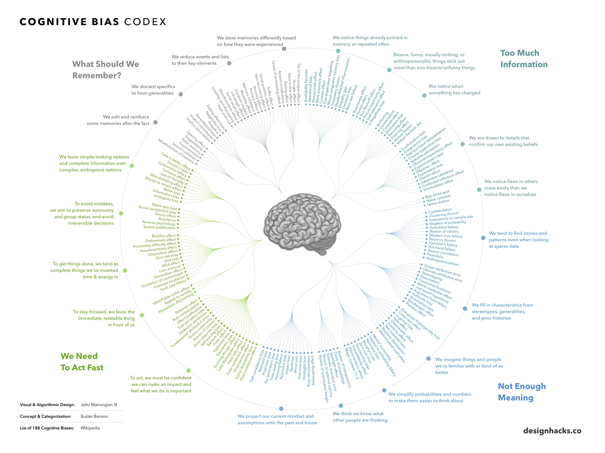

Slide 12
What Can Trigger Our Unconscious Bias?
Ambiguous evidence;
Emotional overload: stress, anger, frustration;
Cognitive overload: complex decision;
Fear of threat;
Emotional and cognitive resources are depleted: tired, low blood sugar (“Hangry”);
Short on time.

Slide 13
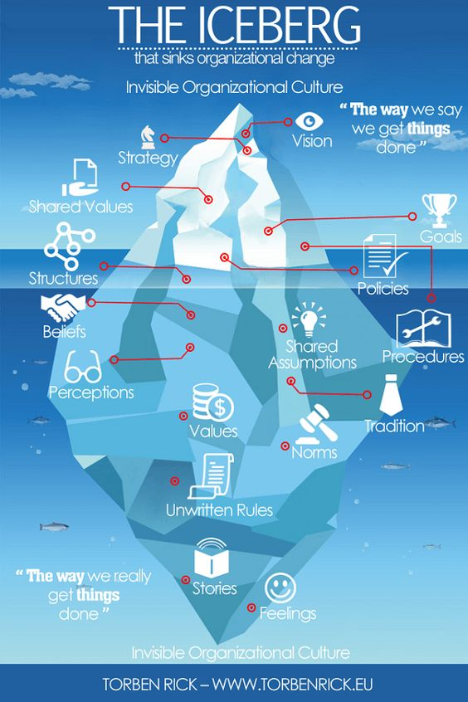
Effects of Unconscious Bias
Failing to respond to real threats or weaknesses;
Seeing threats or weaknesses when none are really there;
Overlooking a person for recruitment, promotion, reward, or development;
Passing up a professional opportunity that would have brought real benefits;
Entering into professional relationships that turn out to be very disadvantageous.

Slide 14
Challenges with Unconscious Bias Training
These types of training do not, and cannot, promote effective change around systemic racism.
Deep debate around stereotypical views and prejudicial judgements have impact, and support a measured and effective way of engaging leaders. It helps leaders to understand that much of bias is not unconscious, rather it is structurally constructed and very much conscious.
If we are going to fix racism, we must do it by focusing on what people are doing consciously. We must focus on the actions that lead to marginalized communities suffering via individuals, and systems, that perpetrate and propagate systemic racism.

Slide 15
Challenges with Unconscious Bias Training: Kellogg Study
According to researchers at Kellogg, “Many Americans hold dear a national narrative of continual triumph over injustice—“essentially, linear racial progress, unending from slavery through Jim Crow to our first Black president.”
In reality, real, systemic inequities exist, particularly around the wealth gap.

Slide 16
Challenges with Unconscious Bias Training: Kellogg Study, cont.
Researchers at Kellogg found that study participants overestimated the degree of inequality in the past (that is, they thought incomes were less equal than they actually were), but they significantly underestimated it in the present.
As a result, their overall perceptions of progress between 1963 and 2016 were way off, with participants believing that far more progress toward income equality had been made than was accurate.
Participants estimated that in 1963, a typical Black family accumulated around $39 for every $100 of wealth accumulated by a White family. (In reality, it was just $5.)
Estimates of the present day were also highly inflated: participants estimated that Black families accumulated $73 for every $100 accumulated by white families, when in reality it was just $10.

Slide 17
Challenges with Unconscious Bias Training: Kellogg Study, cont.
Just learning about racism and unconscious bias isn’t enough to acknowledge the extent of racial inequality in society today.
In fact, in the same Kellogg study, it had the opposite effect.
It turned out, however, that reading about racism didn’t affect participants’ beliefs about the present—it only affected their beliefs about the past. And it affected them in the opposite way than one might expect.
Participants who read about racism estimated more equality in 1963 than those who hadn’t read about racism.

Slide 18
“Third Times a Charm?”
Participants were randomly assigned to one of three groups: one group read an article focused on explicit racial bias, one group read about implicit racial bias, and the control group did not read an article.
The idea was to see if white Americans might better internalize an article about implicit bias, a type of racism more commonly discussed and accepted today, as compared with explicit racism, which white Americans tend to associate with the past.
Yet, when asked to do the same assessments as in the first study, the very same trends emerged: reading about racism—whether implicit or explicit—influenced participants’ assessments of overall racial progress, but it did not improve the accuracy of their estimates of wealth and income equality today. Rather, it changed how they viewed the past, shifting their views about the degree of equality in 1963.

Slide 19
Implications
When faced with evidence that not enough progress has been made, white Americans “have to decide how to integrate the idea [of lack of progress]. We were hoping they would integrate it by acknowledging that the present is less equal than they thought, but instead they revised their estimates of the past.”
It’s clear that just reading about racism wasn’t sufficient to help. And although this approach didn’t work, it’s still essential to find one that does.
“It’s really important that people have an accurate sense of how vast the inequality is, if we hope to garner support for interventions designed to address that inequality.”

Slide 20
What Are Ways to Avoid Unconscious Bias?
Recognize we all have bias
Stop and think! Learn to mistrust your first impressions
Don’t ignore difference – be curious
Challenge negative assumptions and stereotypes
Don’t consciously try to suppress bias
Don’t be too hard on yourself – the emotional impact makes bias more likely
Seek positive examples and role models
Have fun!
Keep processes simple
Schedule demanding cognitive or emotional work away from people decisions
EAT!
Measure levels of trust, openness and honesty

Slide 21
PAUSE
In his book, Everyday Bias (2014), Howard J. Ross discusses what he calls the need for constructive uncertainty to help overcome the risks from our fast, reflexive biases.
He argues that, in a culture that values certainty so much, it is immensely important to find ways to be more uncertain and engage conscious thoughtfulness.
We need, he says, to be able to pause and evaluate the circumstances we are in.
To this end, Ross uses the word PAUSE as an acronym to act as a reminder.
P– Pay Attention to what’s happening beneath the judgement (Event vs Interpretation)
A– Acknowledge or identify your reaction/interpretation/judgements
U– Understand other possible reactions/interpretations/judgements
S– Search for the most constructive/ empowering or productive way to deal with the situation
E– Execute your action plan (Act consistently with what makes the most sense)

Slide 22
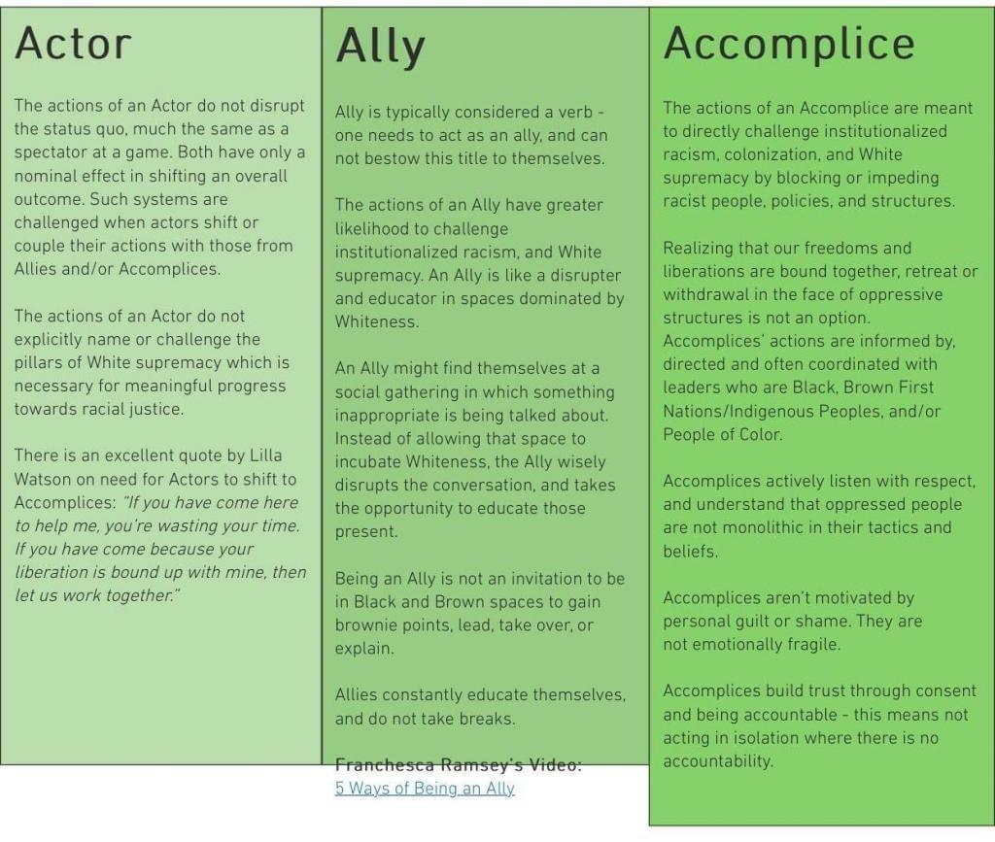
“The Choice is Yours:”
Who Will You Commit to Being in this Season?

Slide 23
Notes:
Poll Title: What are examples of ways you personally can reduce your unconscious bias? https://www.polleverywhere.com/free_text_polls/qJYoQuHkpXw2xTcyWQtWn

Slide 24
To Learn More….
The Klau Center for Civil and Human Rights “Building an Anti-Racist Vocabulary” series (https://klau.nd.edu/initiatives/building-an-anti-racist-vocabulary/)
Podcasts
NPR’s Code Switch
1619
BBC World: Witness Black History
Intersectionality Matters
Movies
13th
Just Mercy
I Am Not Your Negro
Visual Resources
National Museum of African American History and Culture (https://nmaahc.si.edu/explore/collection)
Counternarratives by Alexandra Bell (http://www.alexandrabell.com/public-work)
Local Context
African American Landmark Tour (https://clas.iusb.edu/centers/civil-rights/local-history/african-american-landmark.html)
Racial Wealth Divide in South Bend report (https://prosperitynow.org/sites/default/files/resources/Racial%20Wealth%20Divide%20in%20South%20Bend_ProsperityNow_Final_Rev.pdf)

Slide 25
Questions?
Comments?
Final Thoughts?

Slide 26
Angela R. Logan, Ph.D. Associate Teaching Professor and the St. Andre Bessette Academic Director of the Master of Nonprofit Administration The University of Notre Dame 574-631-7793 (W) 276-224-3843 (C) alogan2@nd.edu Twitter: @AngelaRLogan
References:
Culture Plus Consulting
Adam Grant
Enact Solutions
The Institute of Leadership and Management
KelloggInsight
Forbes
Torben Rick

