Slide 1
Work-based Learning Capstone
An Overview of the Process
Triniti Holden, Field Supervisor I, Pre-Employment Transition Services

Slide 2
Goal Setting for the WBL Capstone
P
R
E
E
T
S
Practical
Feasible placement
Accommodations considered
Relevant
Align with student interest and postsecondary goals
IEP/
transition goals considered
Engaging
Participation
level
Benefit to individual
Enjoyable
Fun
Give insight into future career
Integrated setting
Timely
Useful and considerate of student’s time
Support academic/transition plan
Specific
Job tasks and predicted outcomes are clear
Employer/work site has clear focus for individual

Slide 3
Work-based Learning Capstone Process
Step 1: Complete pages 1-2 of the WBL Personalized Learning Plan (PLP).
Step 2: Submit for Pre-ETS approval. Pre-ETS Specialist will return feedback (approval or denial) within 5 business days.
Step 3: Find the WBL job site. Job site should be individualized to the student and based on student’s strengths, interests, preferences, and needs.
Step 4: Complete Pages 3-5 of the WBL PLP. This should include safety training topics, insurance information, and all signatures. Contractors have 15 business days to submit the completed packet.
Step 5: Student should start WBL.

Slide 4
Personalized Learning Plan
Pages 1&2 of the WBL Agreement
The first two pages of the WBL agreement must be approved by the Pre-ETS team prior to placement.
These pages need to be descriptive and detailed highlighting the student’s answers in a format easily discernable to the Pre-ETS team.
Contractor participation and support should be evident.
Pages 3-5 can be completed and submitted once approval has been given for pages 1&2. The final document must be returned within 15 business days after initial approval.

Slide 5
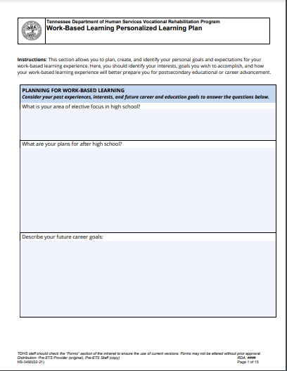
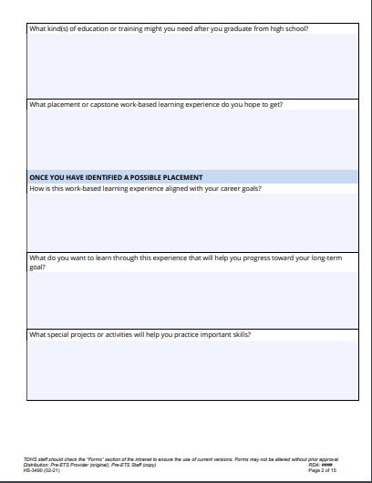
Personalized Learning Plan cont.

Slide 6
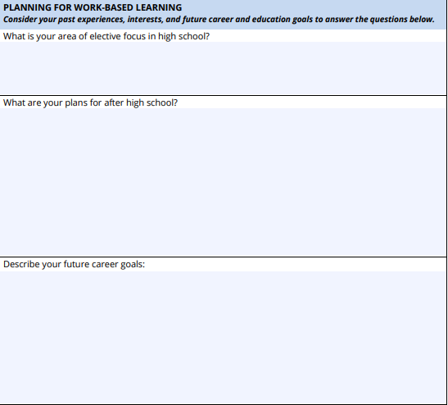
Personalized Learning Plan cont.
When will they graduate? Are they pursuing any specialized diplomas (occupational, etc.)? Be explicit. If you are developing an individualized experience for a student, you should be having conversations about what their course-load looks like. Also, include the Pre-ETS work you have facilitated for the student.
Are they considering any college programs? VR? Are they going straight to work or joining the military? This section should detail information regarding what immediately after high school will look like for them.
What career is the student interested in pursuing? Entrepreneurship? What is their ideal title in their industry of interest? What Pre-ETS work has been done to explore career options? It’s ok if a student details more than one interest but for the sake of the capstone, please only include two relevant to proposed placement.

Slide 7
Personalized Learning Plan cont.
When will they graduate? Are they pursuing any specialized diplomas (occupational, etc.)? Be explicit. If you are developing an individualized experience for a student, you should be having conversations about what their course-load looks like. Also, include the Pre-ETS work you have facilitated for the student.

Slide 8
Personalized Learning Plan cont.
Are they considering any college programs? VR? Are they going straight to work or joining the military? This section should detail information regarding what immediately after high school will look like for them.

Slide 9
Personalized Learning Plan cont.
What career is the student interested in pursuing? Entrepreneurship? What is their ideal title in their industry of interest? What Pre-ETS work has been done to explore career options? It’s ok if a student details more than one interest, but for the sake of the capstone, please only include two relevant to proposed placement.

Slide 10
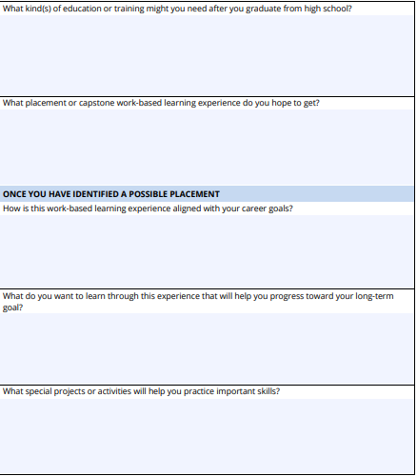
Personalized Learning Plan cont.
This should be specific to their career choice as described in question 3 on page 1. Students need to be aware of what requirements are expected to pursue their careers of interest.
Capstone placement needs to follow the PRE-ETS goal setting and be Practical, Relevant, Engaging, Enjoyable, Timely, and Specific to student
Contractor must make this distinction of alignment clear to student of how this capstone experience will benefit them in pursuing their career of interest.
Direct quotes from students on what they hope to learn and experience from the capstone placement.
What activities will the student engage in to aid them in enhancing employable skills and achieving favorable employment outcomes?

Slide 11
Personalized Learning Plan cont.
This should be specific to their career choice as described in question 3 on page 1. Students need to be aware of what requirements are expected to pursue their careers of interest.

Slide 12
Personalized Learning Plan cont.
Capstone placement needs to follow the PRE-ETS goal setting and be Practical, Relevant, Engaging, Enjoyable, Timely, and Specific to student

Slide 13
Personalized Learning Plan cont.
Contractor must make this distinction of alignment clear to student of how this capstone experience will benefit them in pursuing their career of interest.

Slide 14
Personalized Learning Plan cont.
Direct quotes from students on what they hope to learn and experience from the capstone placement.

Slide 15
Personalized Learning Plan cont.
What activities will the student engage in to aid them in enhancing employable skills and achieving favorable employment outcomes?

Slide 16
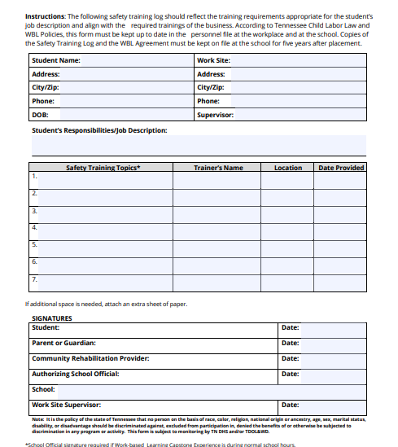
Page 3- Safety Training

Slide 17
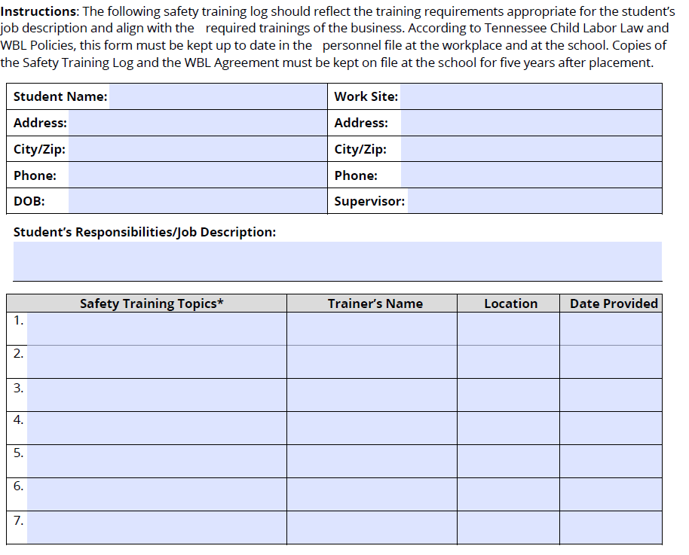
Page 3- Safety Training cont.
Safety training can be planned and implemented by the contractor, work-site supervisor, or in tandem. Participants are not limited to safety training specifics, however training should be in alignment with job-related functions and protocols. For example: If a student is working in a doctors office, appropriate safety training topics would be: Bloodborne Pathogens, HIPAA, and Personal-Protective Equipment.

Slide 18
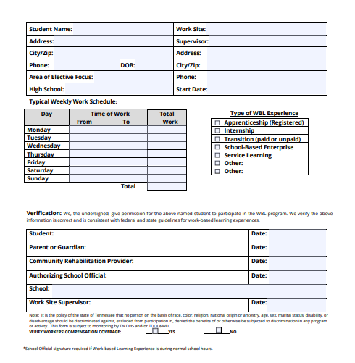
Page 4- Work Schedule

Slide 19
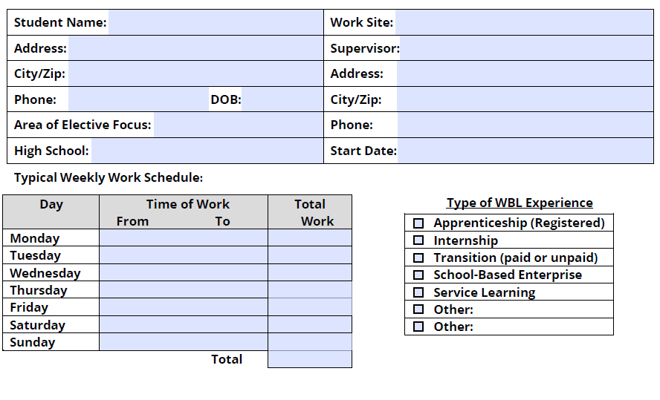
Page 4- Work Schedule cont.
Clearly define the anticipated work hours and type of experience the participant will be engaged in. If work hours deviate from what is listed and updated work schedule needs to be submitted by the contractor. Verify if the work-site has workers’ compensation coverage.

Slide 20
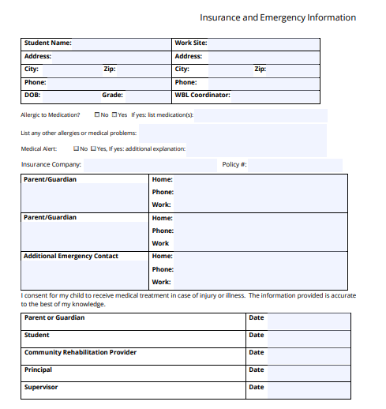
Page 5- Insurance Information

Slide 21
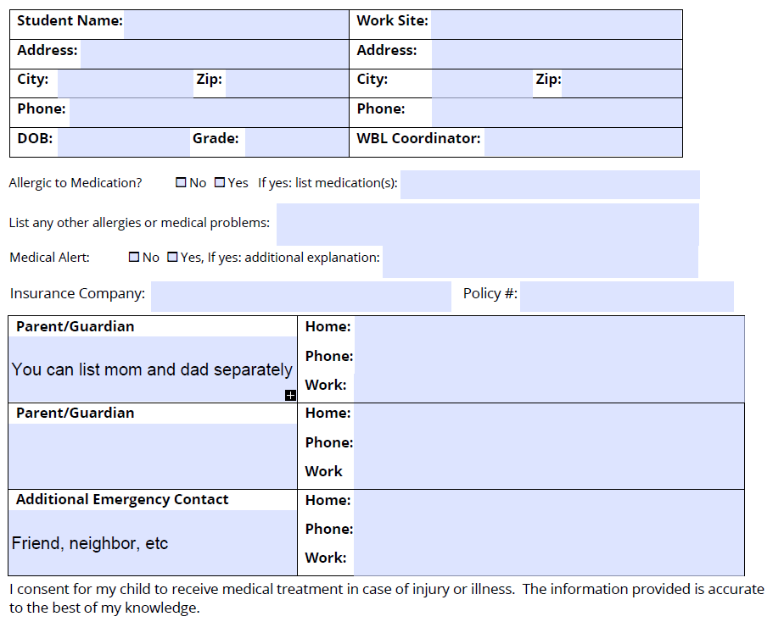
Page 5- Insurance Information cont.
Student personal health insurance should be documented on page 5. Any known allergies or medical problems need to be included, as well as parent and emergency contacts. If a student does not have personal health insurance, contact your Pre-ETS Specialist or Pre-ETS Supervisor to brainstorm other options.

Slide 22
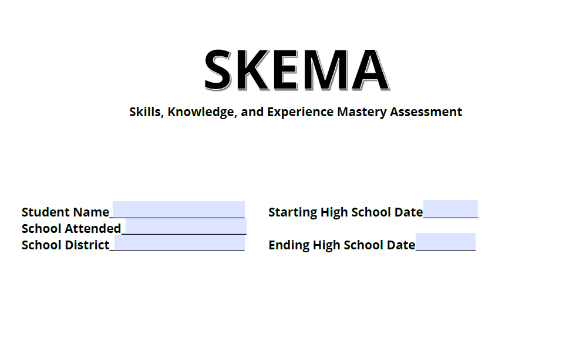
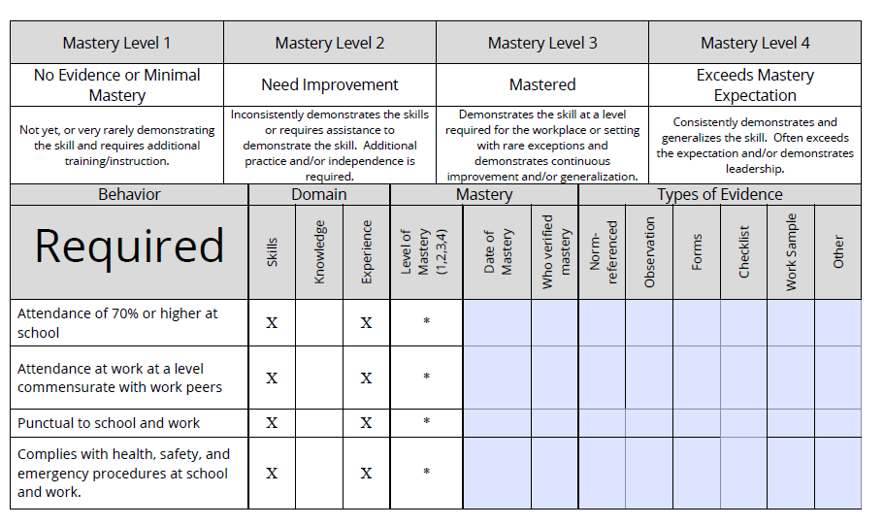
A completed Skills, Knowledge, and Experience Mastery Assessment (SKEMA) must be submitted before the completion of the capstone experience. The SKEMA can be completed by either the contractor, work-site supervisor, or in collaboration together. Another great option is to have the student complete it as a self-assessment.

Slide 23
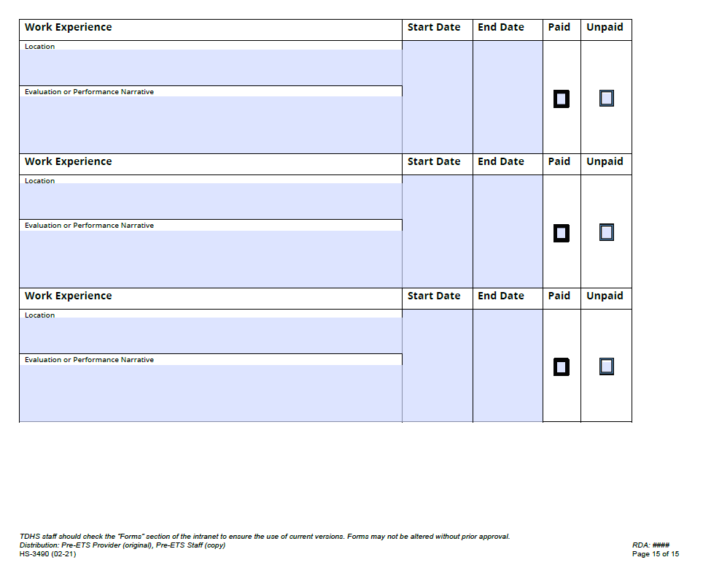
Page 15- Work Experience Documentation
Work Experience Documentation can be utilized by contractor or school officials to survey and evaluate participants in the work setting. This document is ideally used for students pursuing specialized diplomas such as the Occupational Diploma, that require specific work-based learning components.

Slide 24
Things to Consider
All signature fields must be complete on each document, unless the placement occurs outside of instructional time, then a School Authority signature is not necessary.
If the student is also a VR customer, the WBL Capstone must align with the Individualized Plan of Employment (IPE). You will need to coordinate with the Pre-ETS Specialist and VR Counselor assigned to the student’s case.
Take a person-centered approach to the WBL Capstone experience. In other words, facilitate a placement that meets the needs of the individual as opposed to finding a placement and trying to make it fit the individual needs.
15 hours requirement per 30 days

Slide 25

Pre-ETS Team Structure
Shelby Co. Pre-ETS Supervisor – Triniti Holden
West TN Pre-ETS Supervisor – Leeanne Pierce
Middle TN Pre-ETS Supervisor – Gregg Pennington
East TN Pre-ETS Supervisor – Kim Matthews

