Slide 1

10 Year Term Premium is Today’s
Most Important Macro Signal. What Does it Mean for Yields and Asset Allocation?
Bond Dealers of America
2019 National Fixed Income Conference
Oct 24 – 25, 2019
Tom Tzitzouris
Head of Fixed Income Research

Slide 2
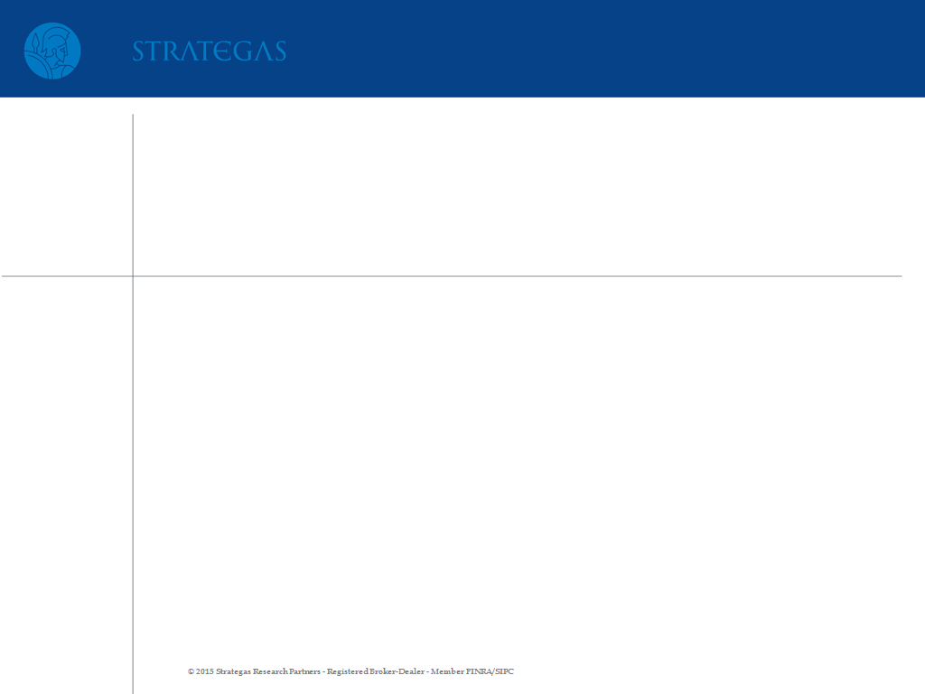
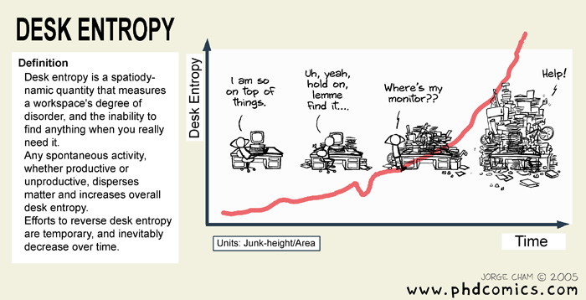
The Change in Entropy Over Time is Constant

Slide 3
The Change in Entropy Over Time is Constant
This is true in physical systems AND economic systems, and more or less suggests the long-run futility of all central planning!

Slide 4
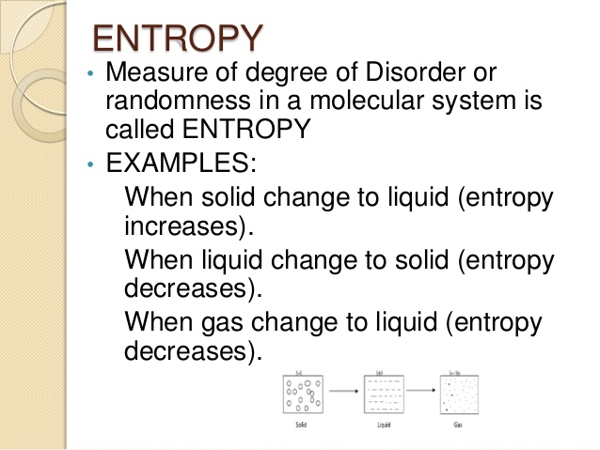
The Change in Entropy Over Time is Constant
In early 2008, when the world was on the verge of financial Armageddon, I had a front row seat as an analyst at Freddie Mac. As markets began to implode, and government intervention became inevitable, I asked our chief risk officer, who in an earlier life was a physicist, what lesson from physics was most applicable to the unfolding market madness of the time. His answer was a simple one; the change in entropy over time is constant. What he meant was that nature has a desired level of order, and that level of order changes with time at a rate that is invariant to our mortal rules. So nothing we do to make the system “safer”, or more “stable” has any real effect on stability.

Slide 5

The Impossible Trinity of Stability
In other words, despite all the wisdom of our rules about required capital for large institutions, safe and sound banking regulations, and even a predictable monetary policy, it all amounts to rearranging the deck chairs on the Titanic.
The Impossible Trinity of Stability:
In economics, we can force order in prices (low and stable inflation), but we lose order in financial markets, so we regulate to reduce financial market volatility, but then we lose social order, as capital is allocated inefficiently and wealth inequality grows

Slide 6
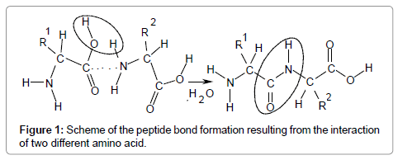
The Impossible Trinity of Stability
Forced order creates chaos, and yet, out of chaos, order forms naturally.

Slide 7
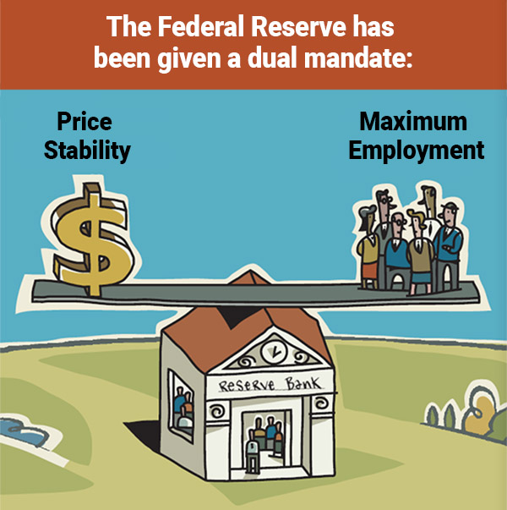
Price Stability has Unintended Consequences
As inflation sits near historical lows, with volatility at lows, we see a world that’s devouring itself with populist uprisings and financial markets that look even “bubblier” than in 2008.
In contrast, during the rebellious years of the 60s, the high inflation of the 70s, and the global political tensions of the 80s, financial markets managed to avoid anything that remotely resembled a systemic collapse (we’d stop short of saying financial markets were “stable”).

Slide 8
Price Stability has Unintended Consequences

Slide 9

Price Stability has Unintended Consequences
The lesson is that complete stability is not attainable. Particularly, there’s an Impossible Trinity of Stability, where any effort to achieve price stability (low inflation), asset market stability (no bubbles) and social stability (no populist revolutions), is futile, because nature simply won’t allow it.

Slide 10

At Economic “Absolute Zero” Bonds Become Puts
When a Central Bank mandate of price stability collides with an economy that’s flatlining, you approach “economic absolute zero”.
At economic absolute zero, much like physical absolute zero, “particles” behave rather oddly. In our economic universe, convexity becomes a perfect substitute for long beta volatility (equity, credit, or commodity beta).
As a result, credit risk free bonds begin to behave more like long puts on beta, but puts that PAY the BUYER. To negate this effect, and to keep markets internally consistent, term premiums begin to go negative!

Slide 11
What is the Term Premium?
FACTS & MYTHS ABOUT THE TERM PREMIUM
The term premium should always be positive for every point on the curve:
TRUE: The reason for this is that the term premium is a measure of market implied volatility, though in yield form. The more uncertain we are about the path of short rates, the higher the yield we require to compensate for this (though convexity actually tends to mute this impact and it’s part of the reason why a term premium model for yields beyond 10 years of maturity is somewhat suspect). But given any bond’s duration, we can transform this into a call premium in dollar form, just like a call premium on a stock. So a negative term premium means that the buyer of the call option (in this case the U.S. Treasury) is being paid for the option it’s buying to term out its debt

Slide 12
What is the Term Premium?
FACTS & MYTHS ABOUT THE TERM PREMIUM
2) The term premium should almost always be upward sloping between 0 and 10 years:
TRUE: This follows from point 1), but another way of thinking about it is that the fair value for every maturity is similar to the “at the money” forward price of the bond. So if the term premium on the 2 year TSY is higher than the term premium on the 10 year, then it suggests that the call option premium on a 2 year option may be too high vs the 10 year option premium, because it may imply that the call option for the 2 year premium is larger than the call option premium for a 10 year option, even though both are struck at the money. That can’t happen. Now, technically, it’s the dollar price term premium that can’t be smaller for the 10 year term note vs a shorter maturity, not the yield term premium. But what we find is that in order not to violate option pricing arbitrages, the yield term premium should also almost always be upward sloping as well (it’s a bit more complex than this, because the option we’re valuing here seems to be “path dependent”, and coupons distort this a bit too, but intuitively, it’s very difficult to get a downward sloping term premium.

Slide 13
What is the Term Premium?
FACTS & MYTHS ABOUT THE TERM PREMIUM
3) The TSY curve should almost always be upward sloping between 0 and 10 years:
TRUE: This follows from point 2) combined with the observation that the term structure of inflation expectations should almost always be flat to upward sloping between 0 and 5 years and should always be flat to upward sloping between 0 and 10 years. Combined, we find that a downward sloping curve can only happen if the market is pricing in an overly tight real rate curve and a flat, to downward sloping breakeven inflation curve, both with very high confidence. In other words, the market is confident a policy mistake is going to be made. Among other things, this tells us that absent a Central Bank policy mistake, curves that are free of credit risk would NEVER be downward sloping.

Slide 14
What is the Term Premium?
FACTS & MYTHS ABOUT THE TERM PREMIUM
4) Downward sloping term premium (and negative term premium) are caused by QE:
FALSE: This is what the Fed is trying to argue, but the argument doesn’t hold up for many reasons. We’ll state one of these right here, but there are other reasons; If QE were the reason why the 10 year term premium is negative, then the German 10 year term premium would be more negative than the U.S. equivalent, and German 10 year yields would be BELOW U.S. equivalents on a currency hedged basis. Neither of these conditions are holding, telling us that it’s not QE that’s causing this.

Slide 15
What is the Term Premium?
FACTS & MYTHS ABOUT THE TERM PREMIUM
5) Negative term premium’s a conscious bet that a shock could hit any time:
TRUE: It’s all about positive carry vs negative carry on long vol options positions.

Slide 16
10 Year Term Premium is the New VIX
If you were looking for a long vol hedge, but hated the thought of being short carry in a low yield environment, then you would be out of options (no pun). But what if you decided that you were only concerned with deflation risk? Then you could slice one tail off of your hedge and make your long vol position a one-sided hedge. You could then pick up long vol protection and deflation protection via long duration Treasuries, at positive carry. That is to say that due to the inverse relationship between price and yield and the high and positive convexity of long duration Treasuries, you could cut your vol hedge into a one tail hedge and actually clip carry. The catch is that even though Treasuries have positive convexity (prices move more rapidly up than down), they also display a peculiar pattern of accelerating price losses in the face of incremental increases in inflation expectations.

Slide 17
10 Year Term Premium is the New VIX

Slide 18
Summer TSY Rally was all about Flight to Quality

Slide 19
U.S. 10 Yr Term Premium Can’t Break Above Zero
It’s something that we’ve been highlighting for years, but it’s still worth noting today; as long as inflation is nonexistent AND range bound, investors can use long convexity as a cheap substitute for long vol. This means that every time the 10 year term premium enters positive territory, the world’s most liquid “long equity put”, actually begins to pay buyers for the put protection they’re buying on global beta. Now who wouldn’t want that??? No wonder this value can’t hold above 0 bps, nor should it, as long as the Fed seems incapable of meeting its 2% inflation target

Slide 20
U.S. 10 Yr Term Premium Can’t Break Above Zero

Slide 21
Bunds Unlikely to be a Shelter During Next Storm
If the next crisis starts anywhere on the European continent, bunds will likely prove to be no more a safe haven than Proctor and Gamble, and the market knows this. And if the next crisis has its roots in Italy, Germany may find itself on the verge of high yield status. Throw in the fact that the German bond market is smaller and less liquid than the U.S., and it’s not a surprise that investors have been paying up on a currency hedged basis to own U.S. Treasuries vs German bunds, or, as of late, seemingly going naked on the currency and increasing their dollar buckets.

Slide 22
Bunds Unlikely to be a Shelter During Next Storm

Slide 23
TSYs Richened Past JGBs Too
Treasuries are near their richest in at least a decade vs JGBs, and once again, we’re at similar levels of richness when converted to yen, though slightly richer than vs bunds.

Slide 24
TSYs Richened Past JGBs Too

Slide 25
TSYs Were Converging to a Uniform Level of Richness
That is until September. Irrespective of your baseline, 10 year Treasuries were converging to a uniform level of richness of 60 to 70 bps by the end of August. One last interesting observation is the following; at the end of August, the roughly 70 bps of richness vs JGBs translates into a price premium for the 10 year Treasury of about $68,000 per $1,000,000 notional. As of the same day, the cost of 1 year, at the money, put protection for ticker SPY, was, you guessed it, $68,000 per $1,000,000! We don’t know why these measures converged, and then suddenly diverged (albeit slightly) at Sept month-end, but the risk of impeachment and dollar weakness could be one cause.

Slide 26
TSYs Were Converging to a Uniform Level of Richness

Slide 27
TSYs Were Converging to a Uniform Level of Richness

Slide 28
Implications for Yield Forecasts: Treasuries as a Substitute for Long Vol Means Yields have a Ceiling
Trade deals will determine the direction of yields over the next 15 months, but term premium considerations will determine the cap and floor of yields. The former, trade, can be broken down into 3 scenarios, which we assign odds to from highest to lowest:
Trade Truce – 55%
Breakdown of Talks – 35%
Growth Supportive Deal – 10%

Slide 29
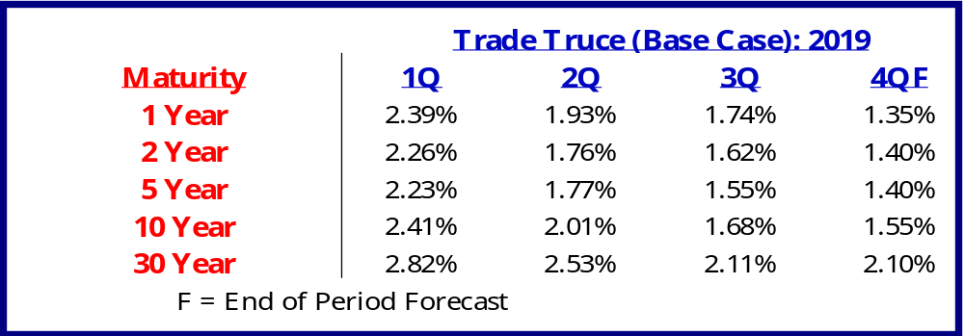
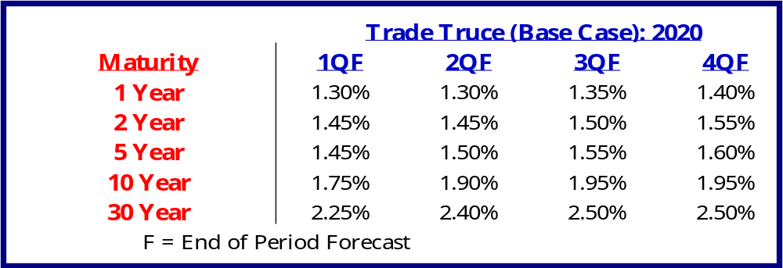
Trade Truce
Trade Truce (Base Case), 55% Odds: Low Inflation, low growth, 2 more cuts in 2019, with a "trade truce" by end of year and no recession in next 18 months. U.S. growth would muddle along, even after 50 bps of cuts in Q4, but growth could begin to revert back to 2.00% (the upper end of the muddle range) by middle of 2020. Demand destruction pauses, but little extra benefit. Yield curve would bull steepen in Q4, and then begin to very slowly bear steepen in 2020, but with 10 year yields capped at 2% for next 15 months.

Slide 30
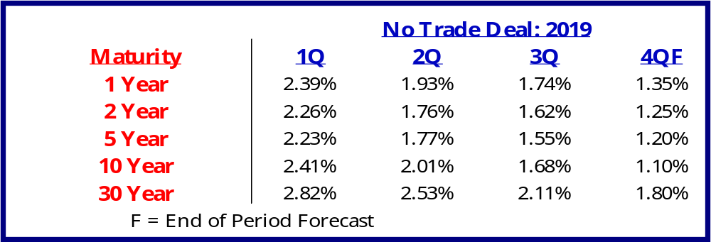
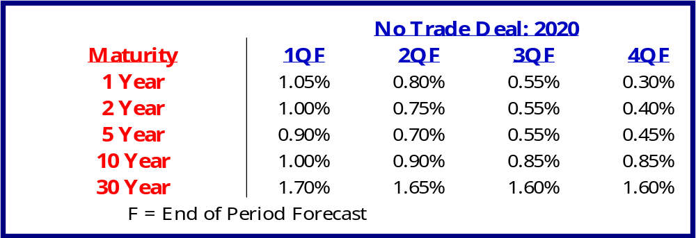
No Trade Deal
No Deal, 35% Odds: Low Inflation, low growth, 2 more cuts in 2019, 4 cuts in 2020, trade discussions break down, recession by middle of 2020. U.S. growth muddles even after 50 bps of cuts in Q4, and then contracts in 2020 as breakdown of trade talks further weakens global demand. Yields plunge across the U.S. curve. With notes in 5 to 10 year part of the curve reaching all-time lows, though yields in front end stop short of reaching the 0 bound.

Slide 31
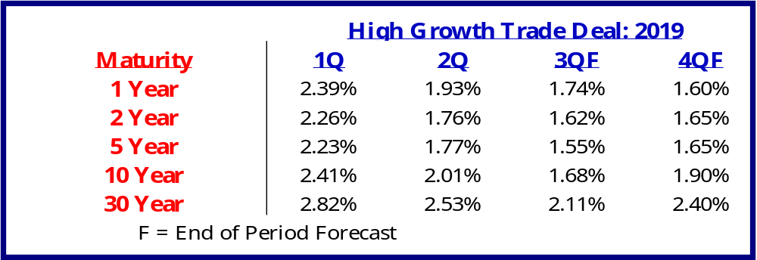
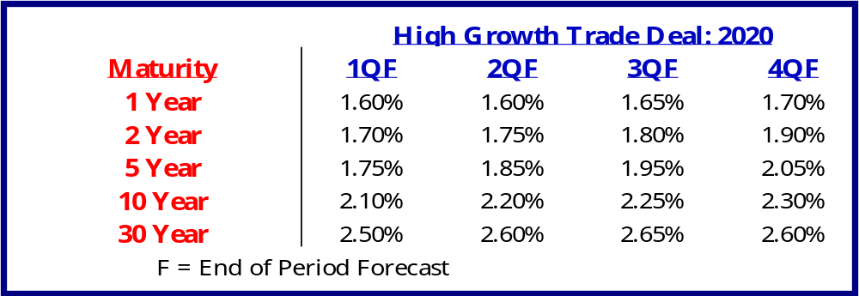
High Growth Trade Deal
High Growth Trade Deal, 10% Odds: Low Inflation, low growth for rest of 2019, 1 more cut in October, but trade deal is signed by end of 2019 or early 2020. U.S. growth muddles for next 2 quarters, despite announcement of deal, as demand destruction persists. But belly of the Treasury curve relinquishes negative term premium by early 2020, slowly bringing curve up to a 2% level. Growth begins to accelerate in the middle of 2020, as business spending picks up, helping to lift the ceiling on rates to around the 2.5% level for longer maturity notes, and just above this for bonds.

Slide 32
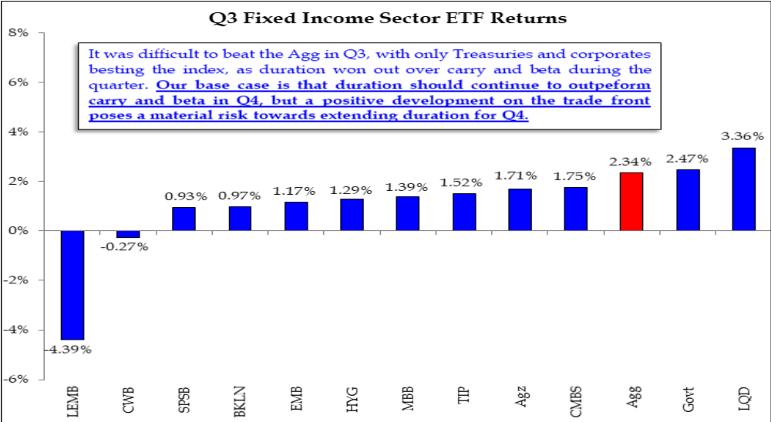
Implications for Asset Allocation: Treasuries as a Substitute for Long Vol Means Treasuries are Too Rich
Trade deals will also likely determine if the U.S. sees recession in the next 12 months, a muddle through, or a growth acceleration, and this will help to determine the trajectory of spreads. But another implication of the ability to substitute convexity for a long volatility position is that investors can add credit beta and MBS alpha and “hedge” with long Treasuries. This has made Treasuries rich.

Slide 33
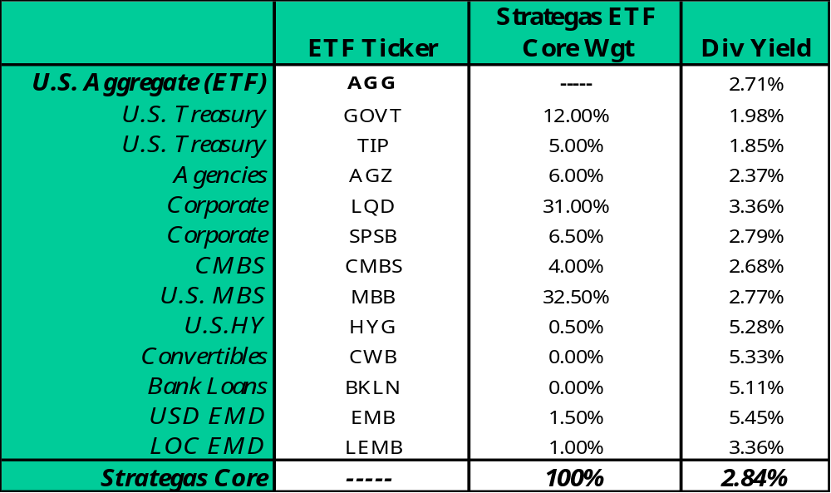
Implications for Asset Allocation: Strategas ETF-Based Core Bond Strategy Allocations

Slide 34
Conclusion: What Does This Mean?
As long as inflation and inflation volatility BOTH remain low, the term premium is likely capped on the 10 year at around 0 bps, and both equities and bonds will remain richly valued by most historical measures.
Debt is neither deflationary, nor inflationary; it’s a catalyst for changes in price levels, like a hydrogen peroxide for price trends.
Debt is not a cause of low growth, at least not directly, rather, it’s a consequence of low growth.
Low growth is a consequence of cyclical forces, secular forces, but, most of all, regulatory forces.
The first place regulatory stagnation begins to affect an economy is via birth rates. That’s because there’s nothing that is a greater sign of economic bullishness, or for that matter, irrational exuberance, than the decision to start a family,. So memo to governments around the world when your population growth rate starts to decline it means you’re interfering with the natural order of things too much and you’re suppressing animal spirits, so stop!
Lastly, economies are Darwinian, whether we want to except that or not. So for those who deny the fairness of the invisible hand of capitalism ,they are doomed to meet the merciless fist of mother nature

Slide 35
APPENDIX – IMPORTANT DISCLOSURES
This communication was prepared by Strategas Securities, LLC (“we” or “us”) and is intended for institutional investors only. Recipients of this communication may not distribute it to others without our express prior consent. This communication is provided for informational purposes only and is not an offer, recommendation or solicitation to buy or sell any security. This communication does not constitute, nor should it be regarded as, investment research or a research report or securities recommendation and it does not provide information reasonably sufficient upon which to base an investment decision. This is not a complete analysis of every material fact regarding any company, industry or security. Additional analysis would be required to make an investment decision. This communication is not based on the investment objectives, strategies, goals, financial circumstances, needs or risk tolerance of any particular client and is not presented as suitable to any other particular client. The intended recipients of this communication are presumed to be capable of conducting their own analysis, risk evaluation, and decision-making regarding their investments.
For investors subject to MiFID II (European Directive 2014/65/EU and related Delegated Directives): We classify the intended recipients of this communication as “professional clients” or “eligible counterparties” with the meaning of MiFID II and the rules of the UK Financial Conduct Authority. The contents of this report are not provided on an independent basis and are not “investment advice” or “personal recommendations” within the meaning of MiFID II and the rules of the UK Financial Conduct Authority.
The information in this communication has been obtained from sources we consider to be reliable, but we cannot guarantee its accuracy. The information is current only as of the date of this communication and we do not undertake to update or revise such information following such date. To the extent that any securities or their issuers are included in this communication, we do not undertake to provide any information about such securities or their issuers in the future. We do not follow, cover or provide any fundamental or technical analyses, investment ratings, price targets, financial models or other guidance on any particular securities or companies. Further, to the extent that any securities or their issuers are included in this communication, each person responsible for the content included in this communication certifies that any views expressed with respect to such securities or their issuers accurately reflect his or her personal views about the same and that no part of his or her compensation was, is, or will be directly or indirectly related to the specific recommendations or views contained in this communication. This communication is provided on a “where is, as is” basis, and we expressly disclaim any liability for any losses or other consequences of any person’s use of or reliance on the information contained in this communication.
Strategas Securities, LLC is affiliated with Robert W. Baird & Co. Incorporated (“Baird”), a broker-dealer and FINRA member firm, although the two firms conduct separate and distinct businesses. A complete listing of all applicable disclosures pertaining to Baird with respect to any individual companies mentioned in this communication can be accessed at http://www.rwbaird.com/research-insights/research/coverage/third-party-research-disclosures.aspx. You can also call 1-800-792-2473 or write: Robert W. Baird & Co., PWM Research & Analytics, 777 E. Wisconsin Avenue, Milwaukee, WI 53202.

