Slide 1

City of Clarksville
Reapportionment 2021
October 28, 2021

Slide 2
Reapportionment - Why
Per the City Charter Article II Section 1. (b) “The City Council shall by ordinance divie the city into twelve (12) wards so that Councilmen elected from wards shall represent substantially equal populations. The City Council may reapportion at any time thereafter, if it deems such action necessary to maintain substantially equal representation based on population. The City Council shall use the latest federal census data whenever a reapportionment is made. Wards shall be reasonable compact and contiguous. A map of such wards shall be filed and maintained by the City Clerk.”
No Deadline – However, the Election Commission is asking the City to adopt their Wards close to when the County does their Districts (Nov – Dec) to avoid duplication of voter card mailings.
Must use the latest Federal Census
  2020 Census Data were received in August
Equal Population = “One Person One Vote”
  Total Citywide Population = 166,722 (Per 2020 Census)
  166,722 / 12 Wards = 13,893 residents per ward rounded down (not necessarily voters)
  Deviation allowed: +/- 5% (+/-830) is generally considered acceptable (10% total deviation required)
  Range for Clarksville = +/- 694 residents or 13,199 – 14,587 residents per ward
    Current Wards Deviation is -% to +% (% total deviation)
    Proposed Wards Deviation is -% - +% (% total deviation)
    Each 1% = 166 residents

Slide 3
Timeline
September 21 – Mayor, Election Administrator, RPC Visit with Comptroller @ RPC
  Showed the current situation and allowed the Comptroller to begin drawing basic Wards.
  Set the potential timeline with the Election Administrator
September 24 – RPC Staff and Election Administrator met again to work on maps
October 20 – Present Ward Maps to City Council Special Session
October 21 – November 19 – Councilmembers may meet with the Election Administrator and RPC to learn more about the changes and reasoning behind them
October 28 – Present to City Council for 1st Reading
November 4 – Vote on 1st Reading
November 5 – November 19 – Public Review @ Election Commission and Online
November 30 – Present for 2nd Reading with any recommended amendments
December 2 – Vote on 2nd Reading
Amendments can be provided between 1st and 2nd Readings.

Slide 4
Reapportionment Approach
Retain as many voters as possible from their 2010 Wards into 2020 Wards
Attain a balanced citywide Ward map within +/- 5% of the target population
  Target = 13,893
  Range = 13,199 – 14,587
Use natural and hard boundaries for districts where possible
  Rivers, railroad tracks, state roads, TVA easements, etc.
  Try not to break up neighborhoods
Maintain the demographic diversity previously held in the district
Respect current councilmembers’ home locations where possible

Slide 5
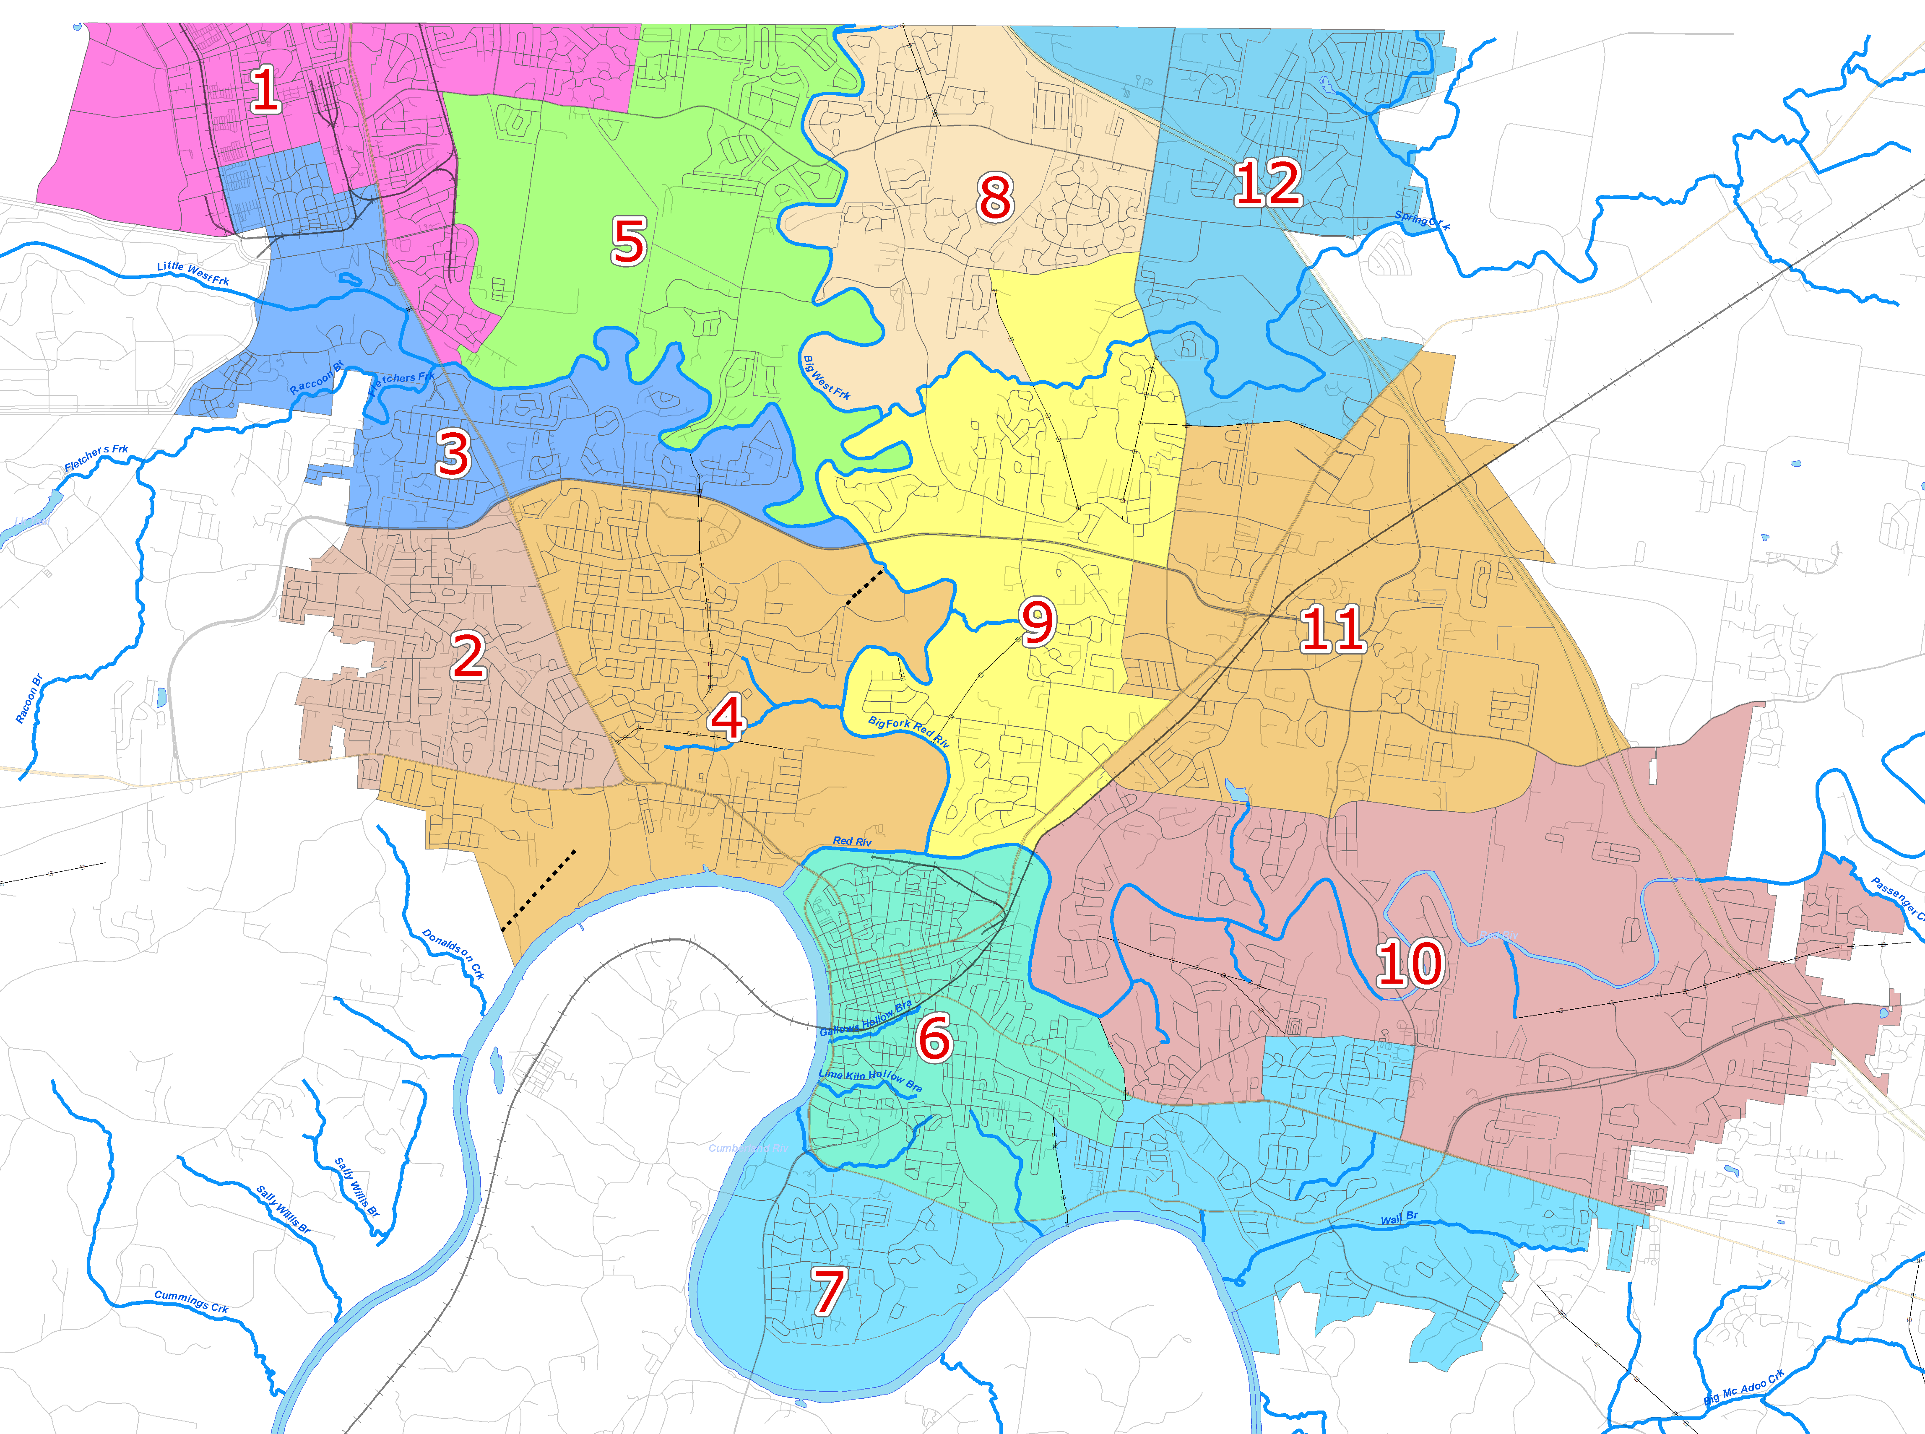
original Ward map (Oct 20)

Slide 6
Proposed Ward map (Oct 20)

Slide 7
Changes to ward map from original
Returned Wards 1 and 5 to original locations for seated councilmembers
  Ward 1 and 3 swapped a small portion of Ft. Campbell
  Ward 1 acquired Tiny Town Rd to Allen Road from Ward 5
  Ward 5 acquired Sunset Meadows from Ward 1
Ward 6 had all three public housing complexes
  Ward 6 gave Maddox Cir. And some land around it to Ward 7
  Ward 6 needed to gain some area south of Providence Blvd to round up in population
Ward 7 was then overpopulated and balance with Ward 10 in an area along Madison Street, Hillcrest Dr, and Memorial Dr.

Slide 8
Demographics

