Slide 1

American Rescue Plan Act (ARPA)
Nursing Recruitment and Retention Grant (NRRG)
Program Design and Delivery of Funds Allocated to the Nebraska Department of Labor under LB 1014

Slide 2




The American Rescue Plan Act created the Coronavirus State Fiscal Recovery Fund (CSFRF) to provide states with resources to respond to the economic impact of the COVID-19 pandemic.
CSFRF Objectives
Respond to COVID-19 and its negative impact on:
  Households
  Small businesses
  Nonprofits
  Specific industries
Provide better wages to essential workers
Assist underemployed and unemployed individuals achieve reemployment
Create retention incentives

Slide 3
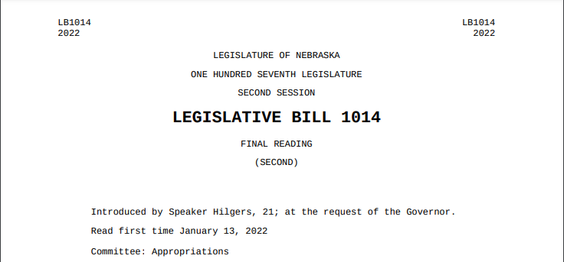
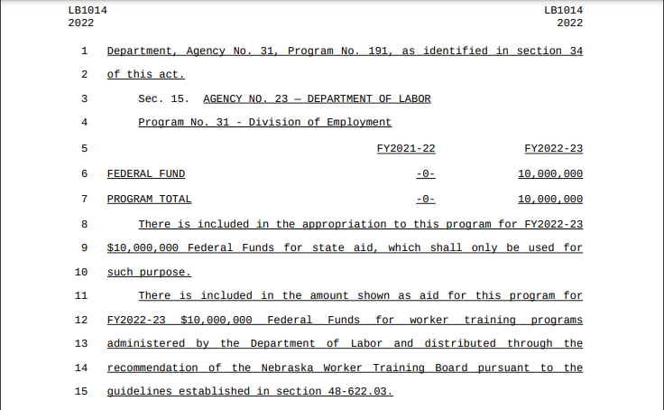
Legislative Bill 1014
Appropriated $10M in CSFRF to the Nebraska Department of Labor for worker training programs administered by the Department and distributed through the recommendation of the Nebraska Worker Training Board (NWTB)

Slide 4
Nebraska Training and Support Cash Fund (NTSC) and the Nebraska Worker Training Program (NWTP)
Public and private job training programs
Recruit workers to Nebraska
Nebraska Training
& Support
Cash Fund
Training new employees of expanding businesses
Maintain a solvent Unemployment Trust Fund
NWTP
LB 1014
Funds

Slide 5
ARPA Programs
Program | Title | Summary | Budget
1 | Teacher Recruitment and Retention Grant (TRRG) | Premium Pay | $4M
2 | Nursing Recruitment and Retention Grant (NRRG) | Premium Pay | $4M
3 | Workforce Development Grant (WDG) | Employment & Training Grants | $2M
4 | Transfer to Unemployment Trust Fund | *Contingency | $0M
*Flexibility exists to transfer funds between programs as needed

Slide 6
NRRG – Applicant and Position Eligibility
Applicant Eligibility Requirements
- Healthcare institution or system with at least one location in Nebraska where direct patient care is provided by RNs, LPNs, or CNAs
Experienced challenges hiring or retaining RNs, LPNs, or CNAs due to the COVID-19 pandemic
Demonstrate a commitment to provide training and professional development to support retention of workers in PP eligible positions
Premium Pay (PP) Eligible Position Requirements
Position filled by a licensed RN, LPN, or CNA and provides in-person patient care in Nebraska in one of the following healthcare settings:
Hospital
Nursing home or long-term care facility
Rehabilitation center
Residential treatment center
Primary-care office
Urgent-care clinic
*Successful applicants will enter into an agreement that may have additional requirements

Slide 7
NRRG – Premium Pay Recipient Eligibility
Premium Pay (PP) Recipient Eligibility Requirements
A licensed RN, LPN, or CNA employed by the recipient employer
Provide in-person patient care in Nebraska in an eligible PP position with the recipient employer
Be in a PP eligible position no later than September 1, 2023 and remain continuously employed in the PP position with the recipient employer through the PP certification date of January 9, 2024
Premium Pay Pay-Scale
$2,500 Registered Nurse
$1,500 Licensed Practical Nurse
$1,000 Certified Nursing Assistant

Slide 8
NRRG – Application Process
Applicants will apply for an NRRG award using the application form provided by NDOL through the application portal located at dol.nebraska.gov. Applications function as requests to reserve a specific amount of grant funds per applicant
- The application form requires the applicant to answer and attest to a series of questions relevant to program eligibility and design, including information about each PP eligible position requested, such as the amount of PP requested for each position and if each position is vacant or occupied at the time of application
- Requests for technical assistance should be submitted to NDOL.ARPA@nebraska.gov
- Note: Healthcare systems applying for a NRRG award on behalf of more than one practice location must submit separate applications for each site
2. The application period begins *September 1st, 2022 and ends by October 2nd, 2023

Slide 9
NRRG – Application Selection Process and Initial Award Notification
1. An Evaluation Committee, designated by the Commissioner of Labor, will review applications on a rolling to verify eligibility requirements of applicants and premium pay positions
2. Based on the review of the evaluation committee and the availability of allocated funds, the Commissioner will make recommendations for NRRG awards to the Nebraska Worker Training Board (NWTB) giving priority to eligible applications filed earliest
3. The NWTB will review the Commissioner’s recommended NRRG awards for compliance with program guidelines. The NWTB will vote on awards recommended by the Commissioner during its scheduled quarterly meetings
4. Once approved by the NWTB, Initial Award Notifications will be issued to recipient employers identifying amount of PP reserved, the positions for which PP has been reserved, and the amount of PP reserved for each position. Applications determined ineligible or not approved by the NWTB will receive notification accordingly

Slide 10
NRRG – Reporting Process
Quarterly Report
Employers must submit a report to NDOL within 15 days of the end of each calendar quarter using a form and method prescribed by the Department. Quarterly reports identify whether the PP eligible position was filled or vacant. For filled positions, employers will provide information about the worker in the position (as specified by NDOL). Recipients who do not submit quarterly reports in a timely fashion may be subject initial award deobligation or decertification
Certification Report
On or before January 15th, 2024 each recipient employer must submit a PP Certification using a form and manner prescribed by NDOL. The Certification form is utilized to verify the recipient met eligibility requirements as of the PP Certification Date (January 9th, 2024). The form includes reporting information and documentation, as specified by the Department, to determine the total amount of eligible premium pay
Notes:
Reports and documents will likely be submitted through the online portal.

Slide 11
NRRG – Final Award Notice and Payment
1. Upon reviewing the Certification Report, NDOL will issue a Final Award Notice that identifies the total amount of funds being awarded and the total premium pay that should be paid to each worker
2. Funds are transferred to the recipient employer to fund premium pay for the approved workers
NOTE: Transfer of funds between the Department and recipient employer will occur only through Electronic Funds Transfer (EFT)
3. Recipient employer pays lump-sum premium payments to each eligible worker as specified in the Final Award Notice.
NOTE: PP wages must be in addition to, and not replace, compensation the worker would have otherwise received. PP is taxable as wage income. Employers are encouraged to treat PP earned by the employee just as they would other wage income and withhold from the additional pay any required taxes.

Slide 12
NRRG Timeline
*September 1, 2022
Application Period Begins
September 1, 2023
PP Eligible Positions Filled
January 9, 2024
PP Certification Date
Initial Award Notices Issued
Final Award Notices and Payments Issued
Quarterly Reporting
January 1, 2023
Guidelines Amended if Unreserved Funds Exist
October 2, 2023
Application Period Ends
January 15, 2024
PP Certification Reports Due
2023
2024

Slide 13

NRRG – Quality Control
As a condition of award, NRRG recipients must agree to cooperate with any quality control (monitoring, auditing, or oversight) activities determined by NDOL or other lawful entities
Quality control activities may occur from the date of application until December 31, 2026

Slide 14
NRRG – Frequently Asked Questions
Coming soon…

Slide 15

Questions?
Applicants, recipients, and other stakeholders should contact the Department for technical assistance or program questions at:
NDOL.ARPA@nebraska.gov

